Slide 1

FIT Timetable
xtesar36, xkohou14, xharmi00
Notes:
Hello, we decided to make an application FIT Timetable.

Slide 2
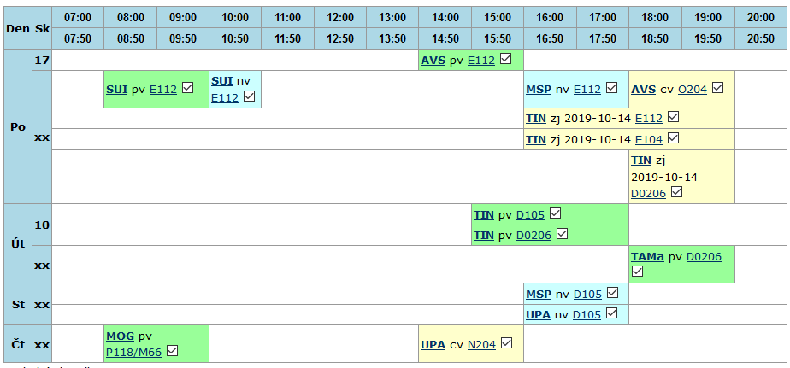
FIT Private Timetable
Notes:
Everybody knows FIT private timetable that you can find in information system but it takes a lot of time to sign up and find the right tab. In addition to it, some blocks in this timetable are useless because they happen just one day in semester and sometime you can see many same bloks under each other and that’s disturbing.

Slide 3
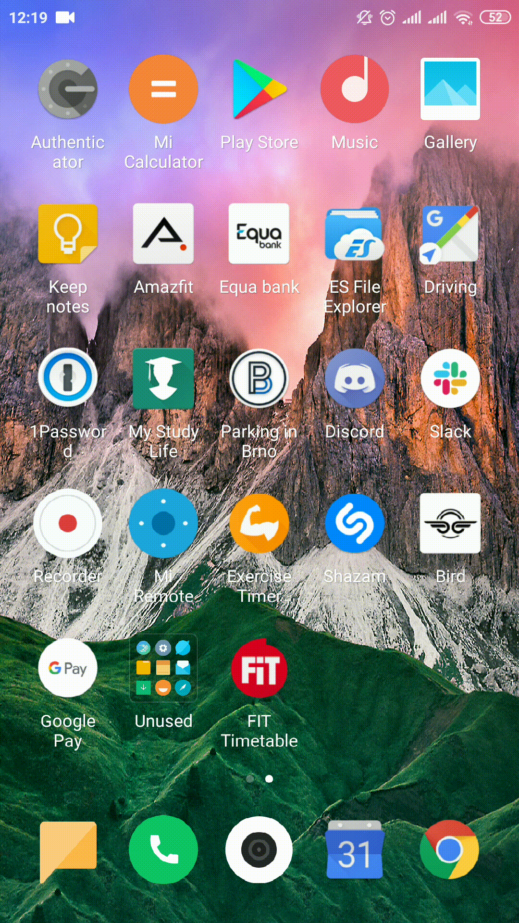
Achievements
signing up to WIS (saving credentials)
loading and updating courses from the private timetable and from the course page (without duplicities)
possibility to remove the course
exporting the calendar to .ics
switching a weeks view
bilingual (CZ, EN)
Notes:
Show what the app looks like, how it is designed. The
best option are videos from the emulator or real use
included in PowerPoint slides (live shows tend to be a
problem, don't do them).
- Describe technical and design internals of your project -
briefly, only the most interesting things.

Slide 4
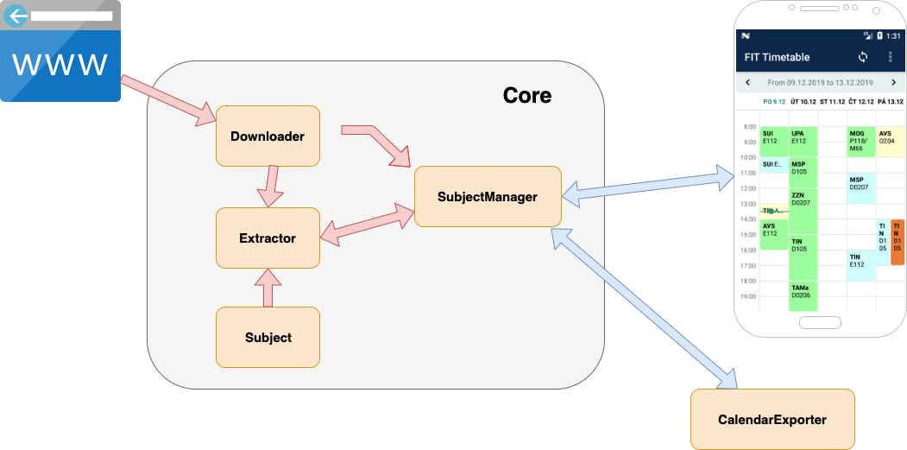
Notes:
Show what the app looks like, how it is designed. The
best option are videos from the emulator or real use
included in PowerPoint slides (live shows tend to be a
problem, don't do them).
- Describe technical and design internals of your project -
briefly, only the most interesting things.

Slide 5
New Experiences
signing up, workings with certificates
problems with different versions of Android (4.4)
exporting to .ics
designing apps (layouts)
using several frameworks
Kotlin and Java
deploying on Google Play
Notes:
Name what experience you take from the project, what you
would do differently given what you know now.

Slide 6


Working in a Team
communication channel - Messenger
GitHub, Android Studio
Notes:
Share your experience of working on the project: how was
the work in the team, what was your experience with the
selected platform, what surprised you positively and
negatively, etc.

Slide 7
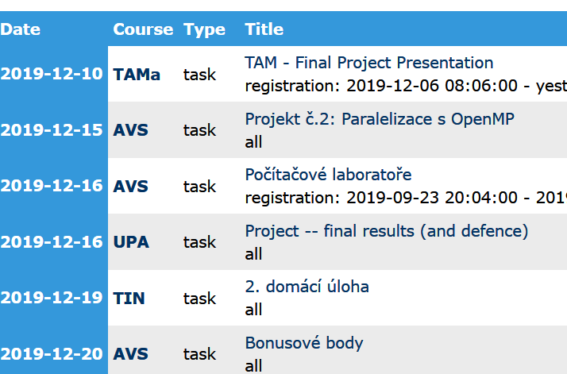
Future Extensions
manually adding courses to the calendar
better synchronisation with the Google Calendar
additional information to the course
downloading also all Tasks and Dates from WIS

Slide 8
FIT Timetable
signing up to WIS (saving credentials)
loading and updating courses from the private timetable and from the course page (without duplicities)
possibility to remove the course
exporting the calendar to .ics
switching a weeks view
bilingual (CZ, EN)
Notes:
Show what the app looks like, how it is designed. The
best option are videos from the emulator or real use
included in PowerPoint slides (live shows tend to be a
problem, don't do them).
- Describe technical and design internals of your project -
briefly, only the most interesting things.

